Slide 1
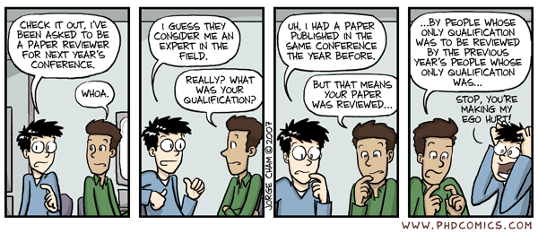
Peer Reviews

Slide 2
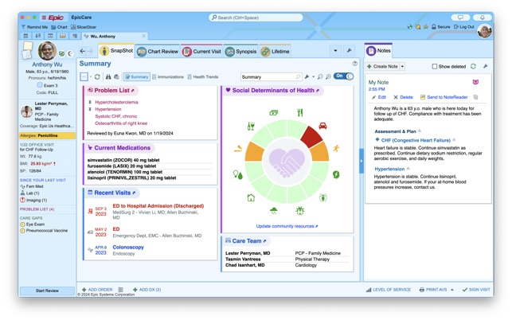
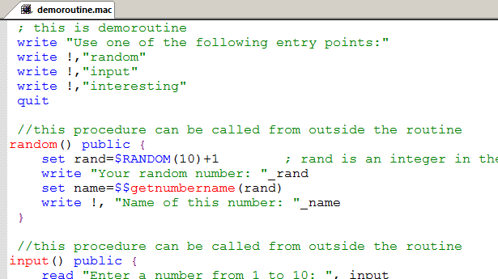
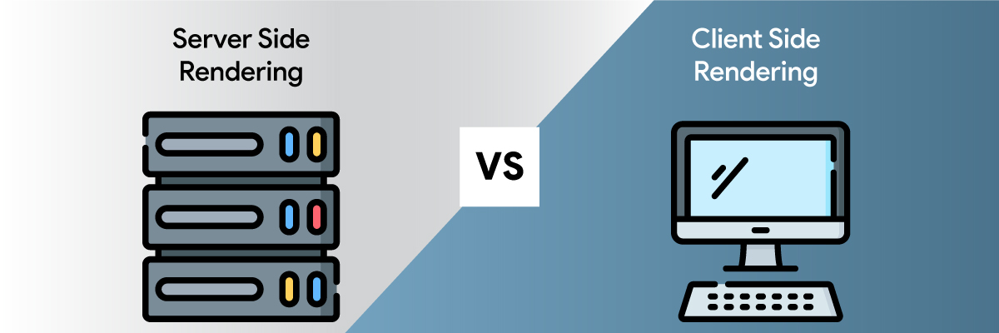
My Peer Review Experience: Coding

Slide 3

PQA 1
Code read and run by dev
Issues raised and suggestions made (QAN)
PQA 2
Code read and run by dev
Issues raised and suggestions made (QAN)
QA
Workflow tested by non-dev
Bugs identified and documented (QAN)

Slide 4






My Peer Review Experience: Journals

Slide 5
Authors
Editor-in-chief
Reviewer 1
Authority on their project
Broad field knowledge
Specific field knowledge
Handling editor
Reviewer 2
Reviewer 3
Hyperspecific field knowledge
Desk reject
Desk reject
Accept
Minor revision
Major revision
Reject

Slide 6
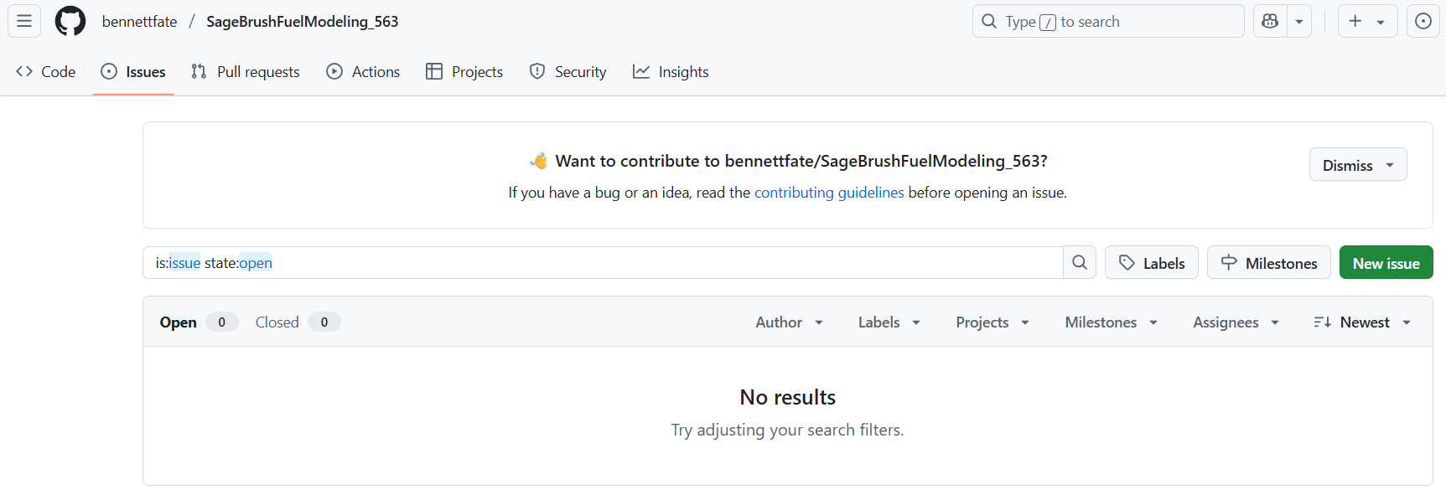
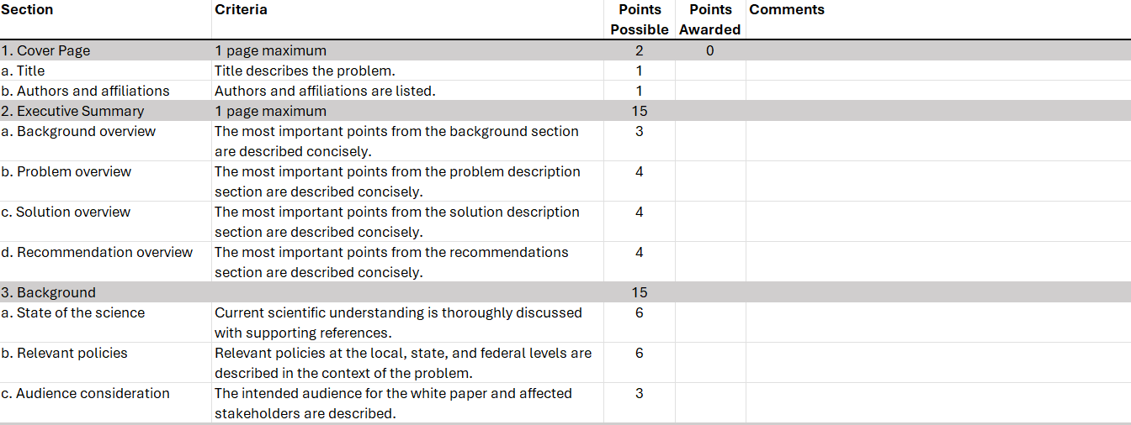
Main Components of Your Reviews
GitHub Repositories
Data Sourcing
Data Analysis
Figures and Tables
Project White Paper
Praise
Constructive Criticism

Slide 7
